Slide 1
Power Bi
Power BI Microsoft ka ek Data Visualization aur Business Intelligence tool hai.

Slide 2
Power bi
Power BI is a data visualization and business analytics tool developed by Microsoft. It allows users to connect to various data sources like Excel, SQL, or cloud services, clean and transform the data, and then create charts, graphs, and dashboards. These insights help businesses make better decisions.

Slide 3
Power BI Microsoft का एक Business Intelligence टूल है, जो अलग–अलग sources से data लेकर उसे analyze करता है और interactive reports व dashboards बनाने में मदद करता है।
Power BI एक data visualization और business analytics tool है। इसके जरिए हम Excel, SQL, MySQL, PostgreSQL और cloud services से data connect कर सकते हैं। फिर data को clean व transform करके charts, graphs और dashboards बना सकते हैं, जिससे business decisions लेना आसान हो जाता है।

Slide 4
Power BI kya hai?
Power BI Microsoft ka ek Business Intelligence aur data visualization tool hai, jisse hum data ko analyze karke interactive reports aur dashboards bana sakte hain.

Slide 5
Power BI kin-kin data sources se connect ho sakta hai?
Power BI Excel, SQL Server, MySQL, PostgreSQL, Oracle, Cloud services (Azure, Google Analytics), CSV files aur APIs se connect ho sakta hai.

Slide 6
Power BI ke main components kaun se hain?
Power Query → Data cleaning or transformation ke liye
Power Pivot → Data modeling or calculations ke liye
Power View & Power Map → Data visualization ke liye
Power BI Service → Reports ko publish aur share karne ke liye

Slide 7
Power BI ke benefits kya hain?
Easy to use (Drag & Drop interface)
Multiple data sources connect kar sakta hai
Real-time dashboards available hain
Reports ko easily share kar sakte hain
Cost-effective hai aur market me high demand hai

Slide 8
Power BI aur Excel me kya difference hai?
Excel mainly basic analysis aur reporting ke liye use hota hai, jabki Power BI advanced visualization, automation, real-time dashboards aur large data sets handle karne ke liye use hota hai.
"Power BI ek tool hai jo raw data ko meaningful dashboards aur reports me convert karta hai."

Slide 9
Project Start (Import Data)
Power Query → Data cleaning aur transformation ke liye
Power Pivot → Data modeling aur calculations ke liye
Power View & Power Map → Data visualization ke liye
Power BI Service → Reports ko publish aur share karne ke liye

Slide 10
1. Power Query → Data Cleaning & Transformation ke liye
Power Query ek tool hai jo Power BI me data ko import, clean aur transform karne ke liye use hota hai.
Agar data Excel, SQL, CSV ya kisi aur source se aaya hai aur usme duplicates, null values ya unwanted columns hain, to Power Query ki madad se unhe remove kar sakte hain.
Aap columns ko merge/split kar sakte ho, data types change kar sakte ho, filters laga sakte ho.
Matlab Power Query data ko analysis ke liye ready form me convert karta hai.
📌 Example: Agar ek Excel sheet me customer names alag-alag format me likhe hain (ABC Ltd., abc ltd, ABC LTD), to Power Query unhe ek format me standardize karne me help karega.

Slide 11
2. Power Pivot → Data Modeling & Calculations ke liye
Power Pivot ek data modeling engine hai jo large data sets ke beech relationships banata hai aur calculations perform karta hai.
Isme DAX (Data Analysis Expressions) formulas use hote hain, jisse aap custom calculations bana sakte ho.
Aap multiple tables ke beech relation bana kar ek model ready karte ho jisse proper analysis possible ho.
📌 Example: Agar ek table me “Sales Data” hai aur dusre table me “Customer Info” hai, to Power Pivot dono ko link karke ek single model bana dega jisse combined analysis possible ho jaye.

Slide 12
Power View & Power Map → Data Visualization ke liye
power View aur Power Map dono visualization tools hain.
Power View: Interactive charts, graphs, tables banane ke liye use hota hai. Isme drag-and-drop karke easily visuals create karte hain.
Power Map: Map-based visualization ke liye use hota hai (geographical data ke liye). Agar data me “City, Country, Latitude-Longitude” hai to aap map visualization bana sakte ho.
📌 Example: Agar aapke paas “Sales by Country” data hai, to Power Map usse world map par visualize kar dega jisse easily pata chalega kis country me sales zyada hain.

Slide 13
4. Power BI Service → Reports ko Publish & Share karne ke liye
Power BI Service ek cloud platform hai jaha aap apne reports aur dashboards publish kar sakte ho.
Isse aap apni team ya organization ke saath reports share kar sakte ho.
Isme real-time dashboards banate hain jo automatic update hote rehte hain jab data source update hota hai.
Mobile app ke through bhi reports access kiye ja sakte hain.
📌 Example: Agar aapne ek Sales Dashboard banaya hai aur usse apni company ke management ke sath share karna hai, to aap usse Power BI Service par publish karke access de doge.

Slide 14
Power Query = Data clean & prepare
Power Pivot = Data model & calculations
Power View/Map = Data visualization
Power BI Service = Publish & share

Slide 15
Power BI
Power BI raw data ko analyze karke usse interactive charts, reports aur dashboards mein convert karta hai.
Example:
Agar company ke paas sales ka data hai:
January → ₹50,000
February → ₹70,000
March → ₹90,000
Power BI se hum dekh sakte hain:
📊 Kis month mein sales zyada hui
📈 Sales growth kitni hai
🏆 Kaunsa product sabse zyada sell hua
🔍 Different filters laga kar data analyze karna
📋 Interactive dashboard banana

Slide 16
Ribbonरिबन चार्ट

Slide 17
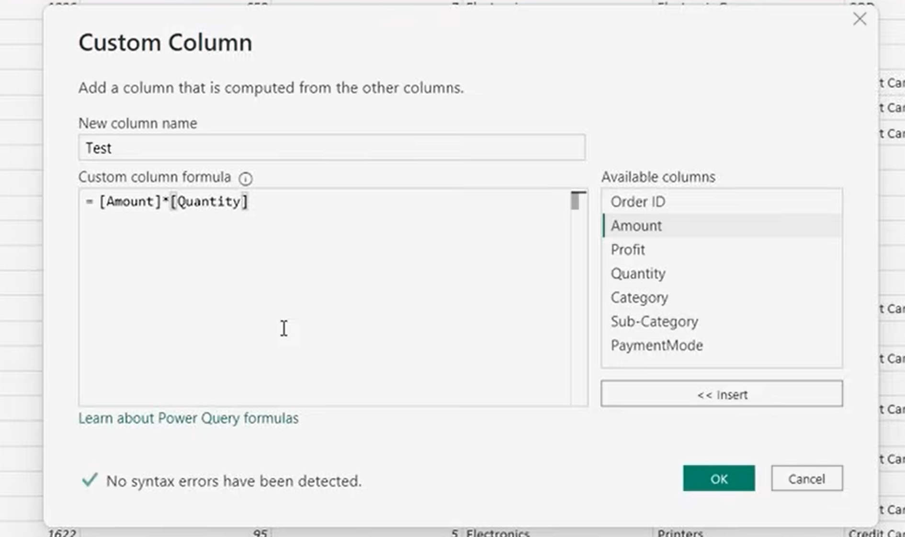
Power BI Dashboard Project
Data load
Transform data

Slide 18
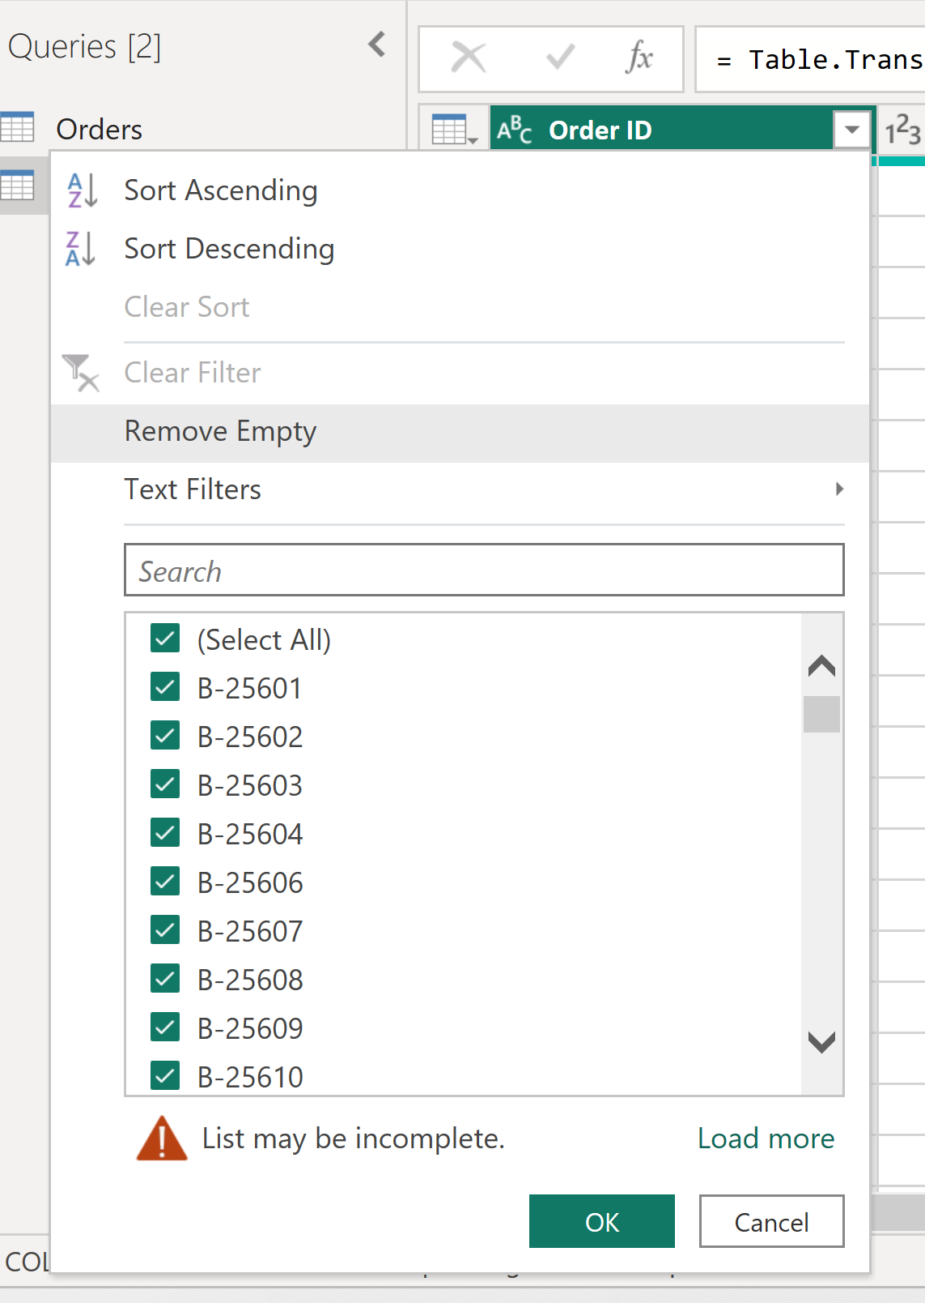
Null Value check

Slide 19
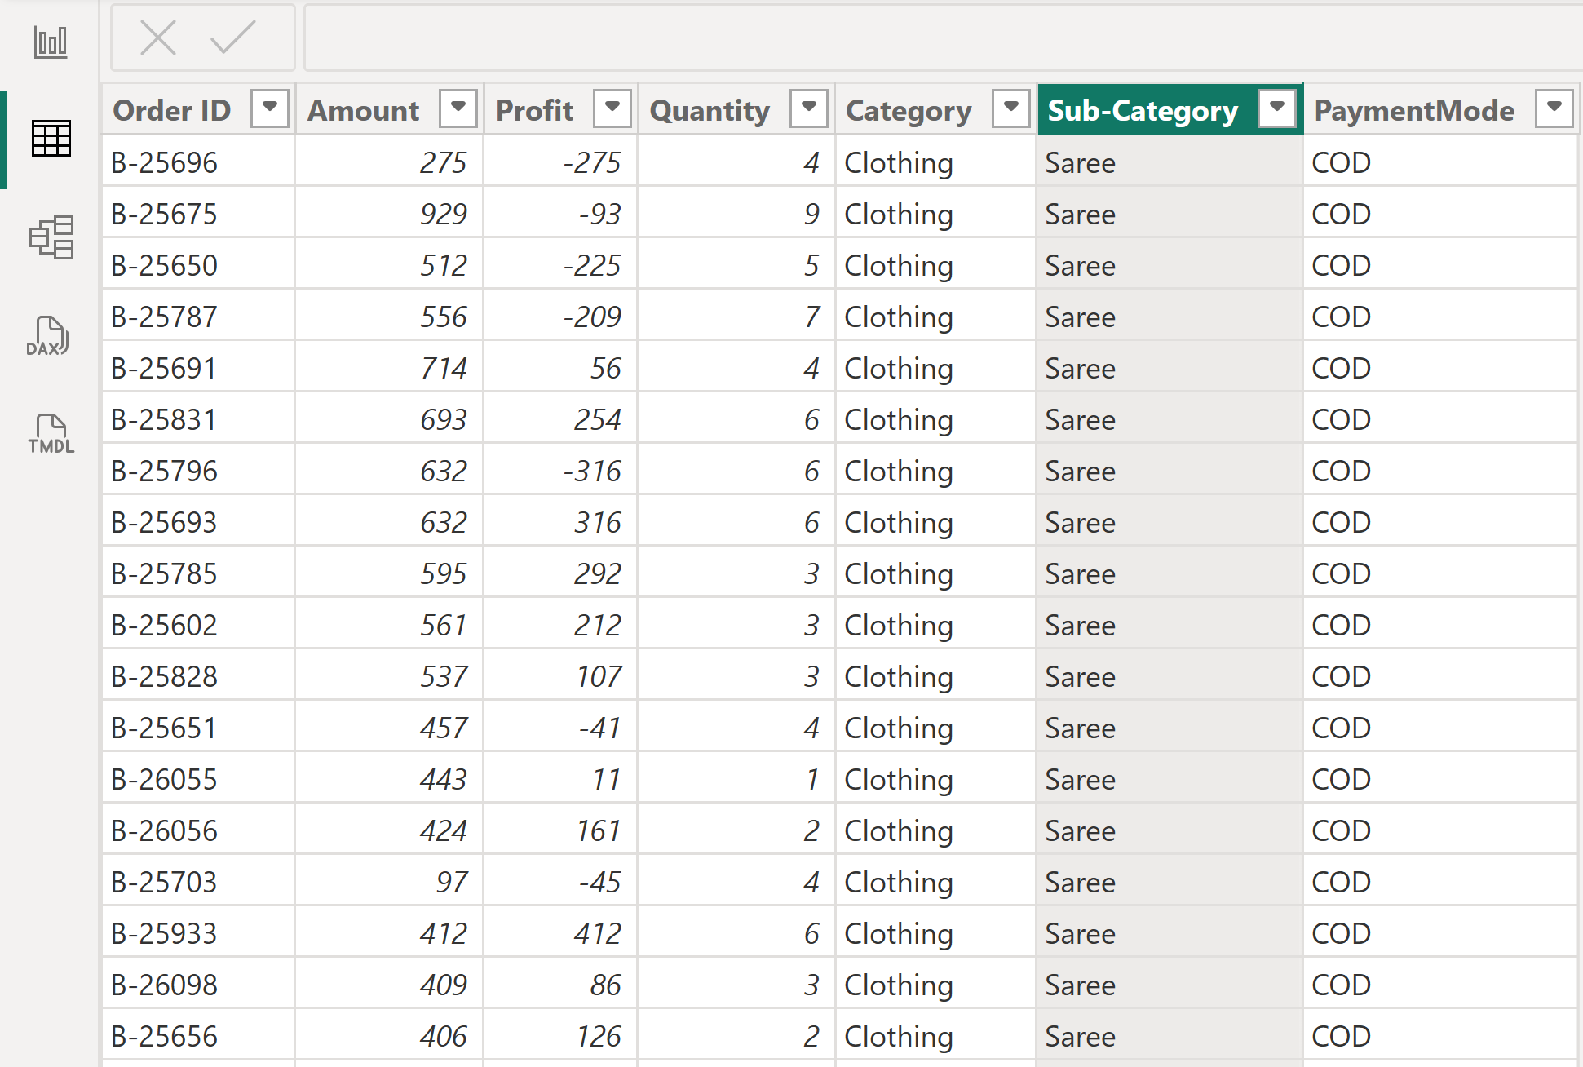
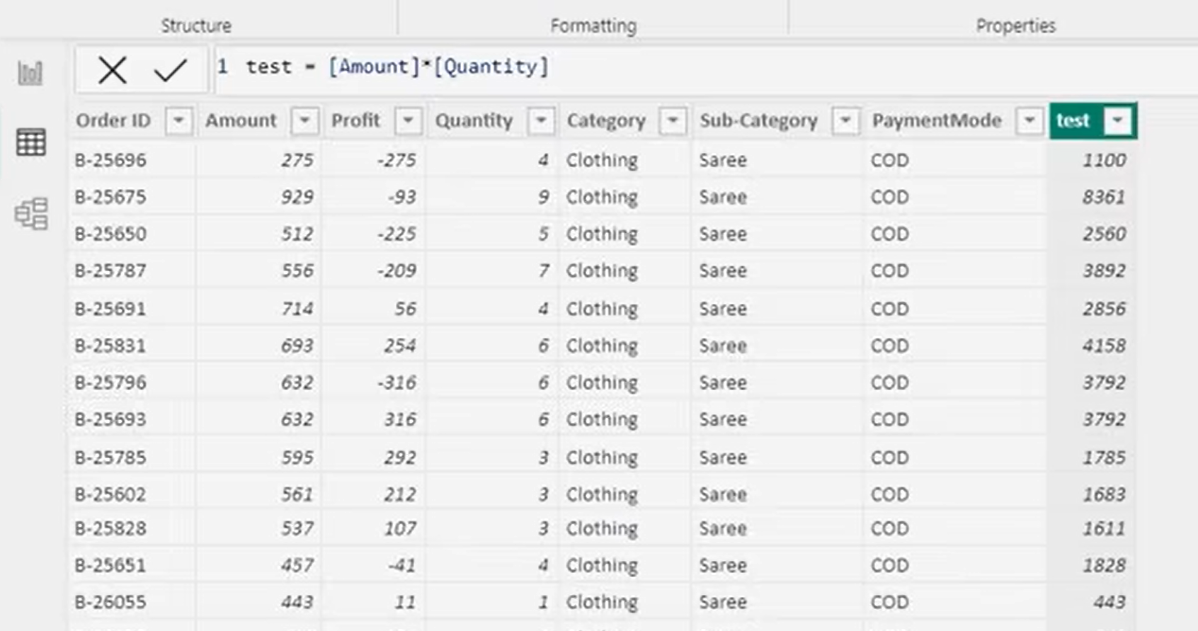
Table view (Data type dekhna ho)
New col add karn a (text =[amount]*[qty])

Slide 20
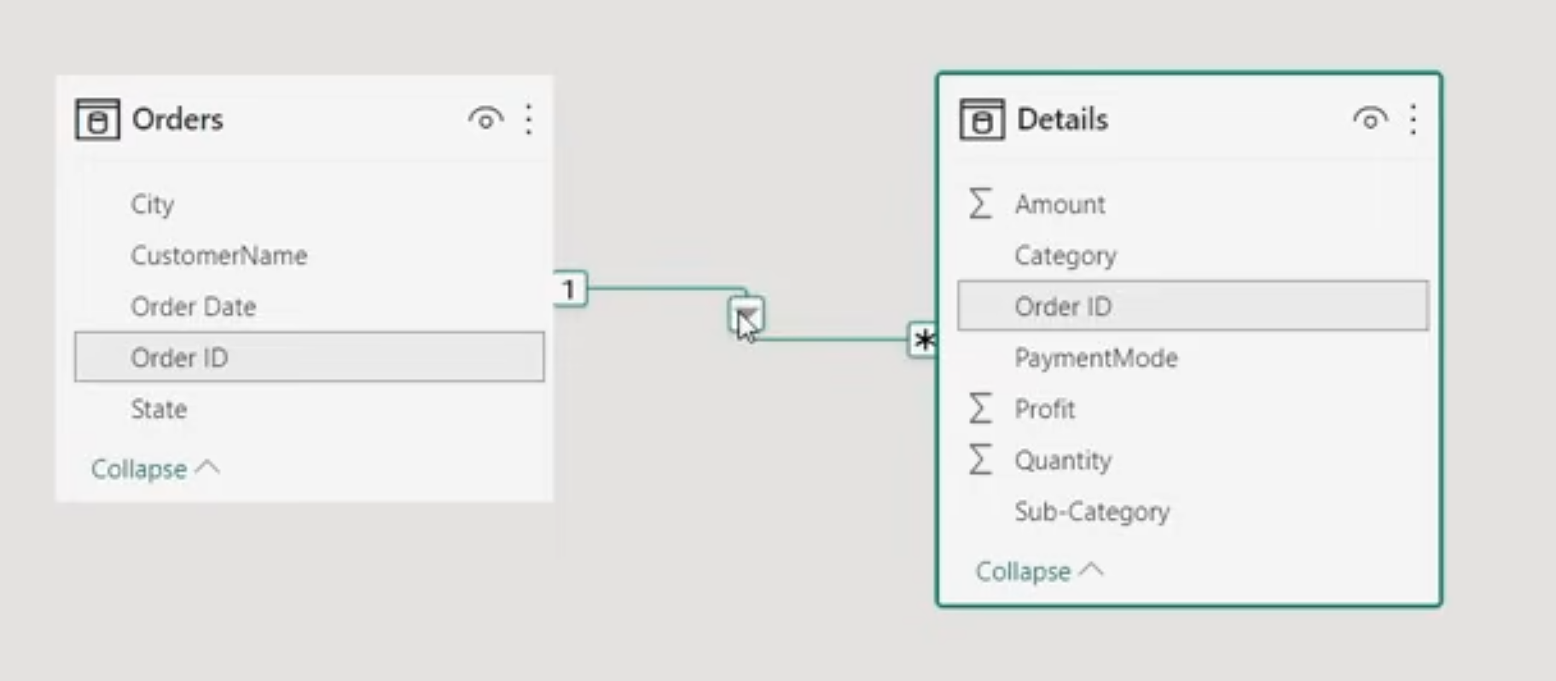
Model View

Slide 21
1. One-to-One (1 : 1)
Ek ka ek
Example:
Employee → Employee Details
1 Employee → 1 Detail
Matlab dono tables mein ID unique hai.
👉 Example: Employee 101 ka sirf ek profile hai.

Slide 22
2. One-to-Many (1 : *)
Ek ke bahut
Example:
Customer (1) → Orders (*)
Rahul ek customer hai, lekin Rahul ke bahut saare orders ho sakte hain.
Rahul
↓
Order 101
Order 102
Order 103
👉 1 Customer → Many Orders

Slide 23
3. Many-to-One (* : 1)
Bahut ka ek
Ye basically One-to-Many ka ulta direction hai.
Orders (*) → Customer (1)
Bahut saare orders ek customer ke ho sakte hain.
Order 101 ──┐
Order 102 ──┼──→ Rahul
Order 103 ──┘
👉 Many Orders → 1 Customer

Slide 24
4. Many-to-Many (* : *)
Bahut ke bahut
Example:
Students (*) ↔ (*) Courses
Ek student multiple courses kar sakta hai.
Aur ek course ko multiple students kar sakte hain.
Rahul → Python
Rahul → SQL
Amit → SQL
Amit → Power BI
👉 Many Students ↔ Many Courses

Slide 25

Bas ye 4 line yaad kar lo

Slide 26
Many-to-One (* : 1) kya hota hai?
Power BI mein Many-to-One ka matlab hai:
Ek table mein same value bahut baar aa sakti hai, aur doosri table mein wahi value sirf ek baar hoti hai.
Yahan P01 3 baar aa raha hai.
(Sales Table)
Order_ID | Product_ID | Sales
101 | P01 | 500
102 | P02 | 700
103 | P01 | 300
104 | P03 | 900
105 | P01 | 600

Slide 27
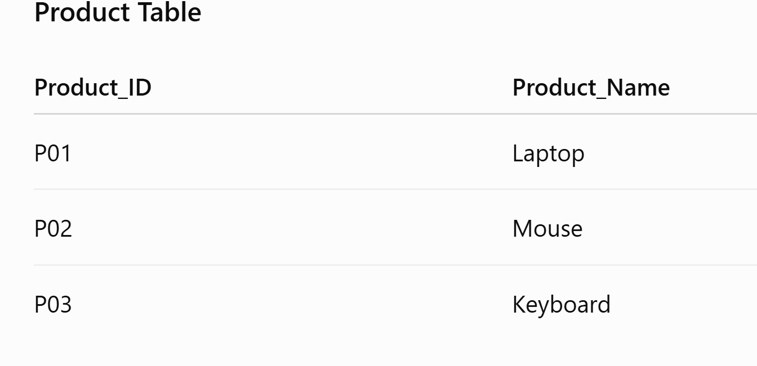
Product Table:
Yahan P01 sirf 1 baar hai.
Isliye relationship:
Sales (*) → Product (1)
* aur 1 ka matlab
* = Many → value multiple times aa sakti hai
1 = One → value sirf ek baar honi chahiye

Slide 28
Jahan ID repeat ho rahi hai = Many (*)
Jahan ID unique hai = One (1)

Slide 29
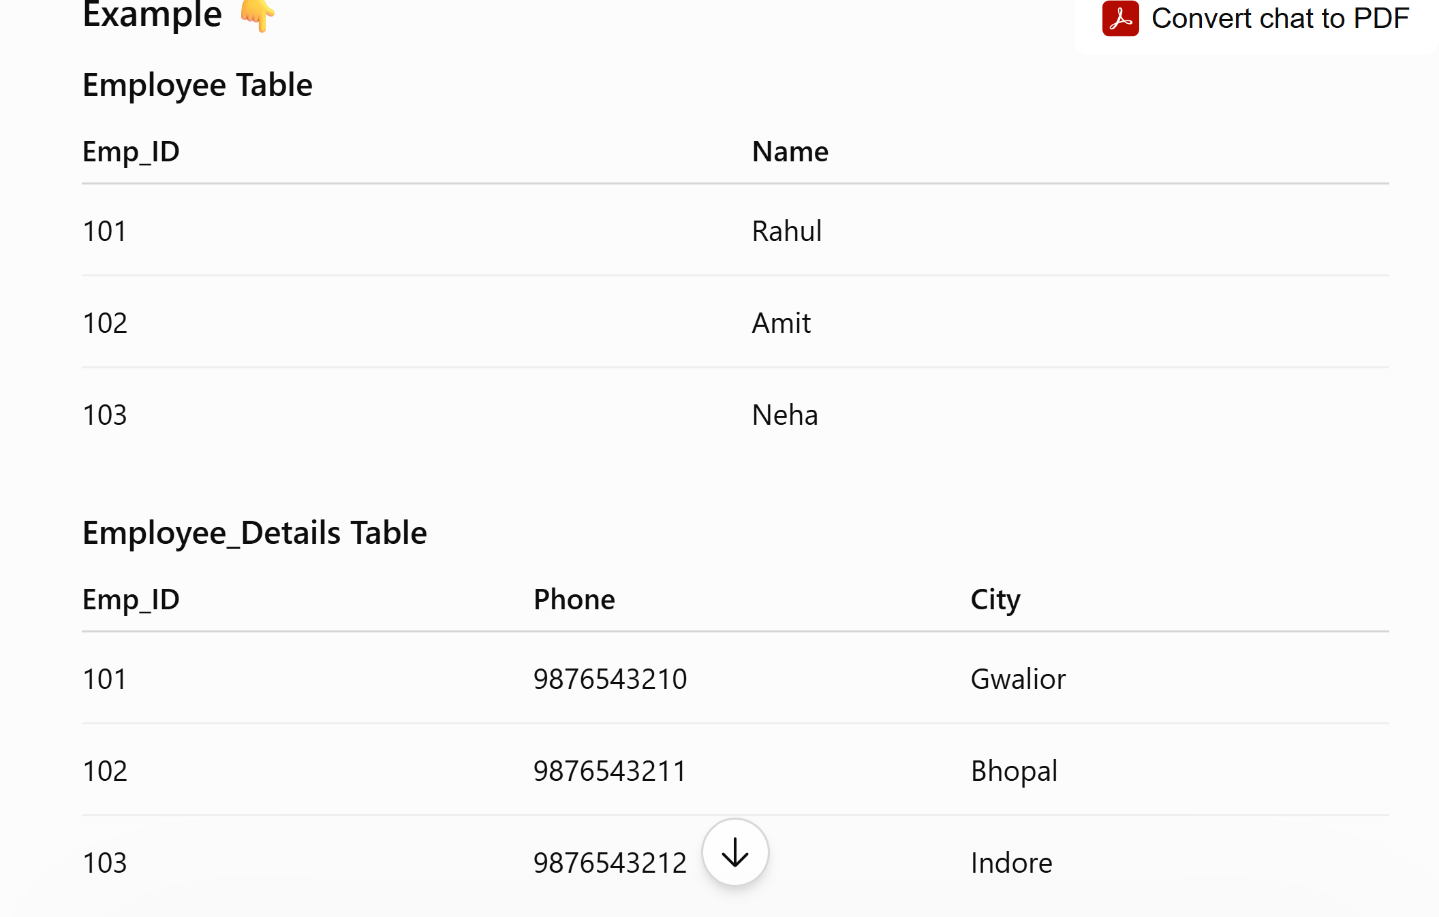
One-to-One (1 : 1) kya hota hai?
Power BI mein One-to-One (1:1) ka matlab hai:
Dono tables mein relationship wali value unique hoti hai.
Ek value pehli table mein sirf 1 baar aur doosri table mein bhi sirf 1 baar hoti hai.

Slide 30
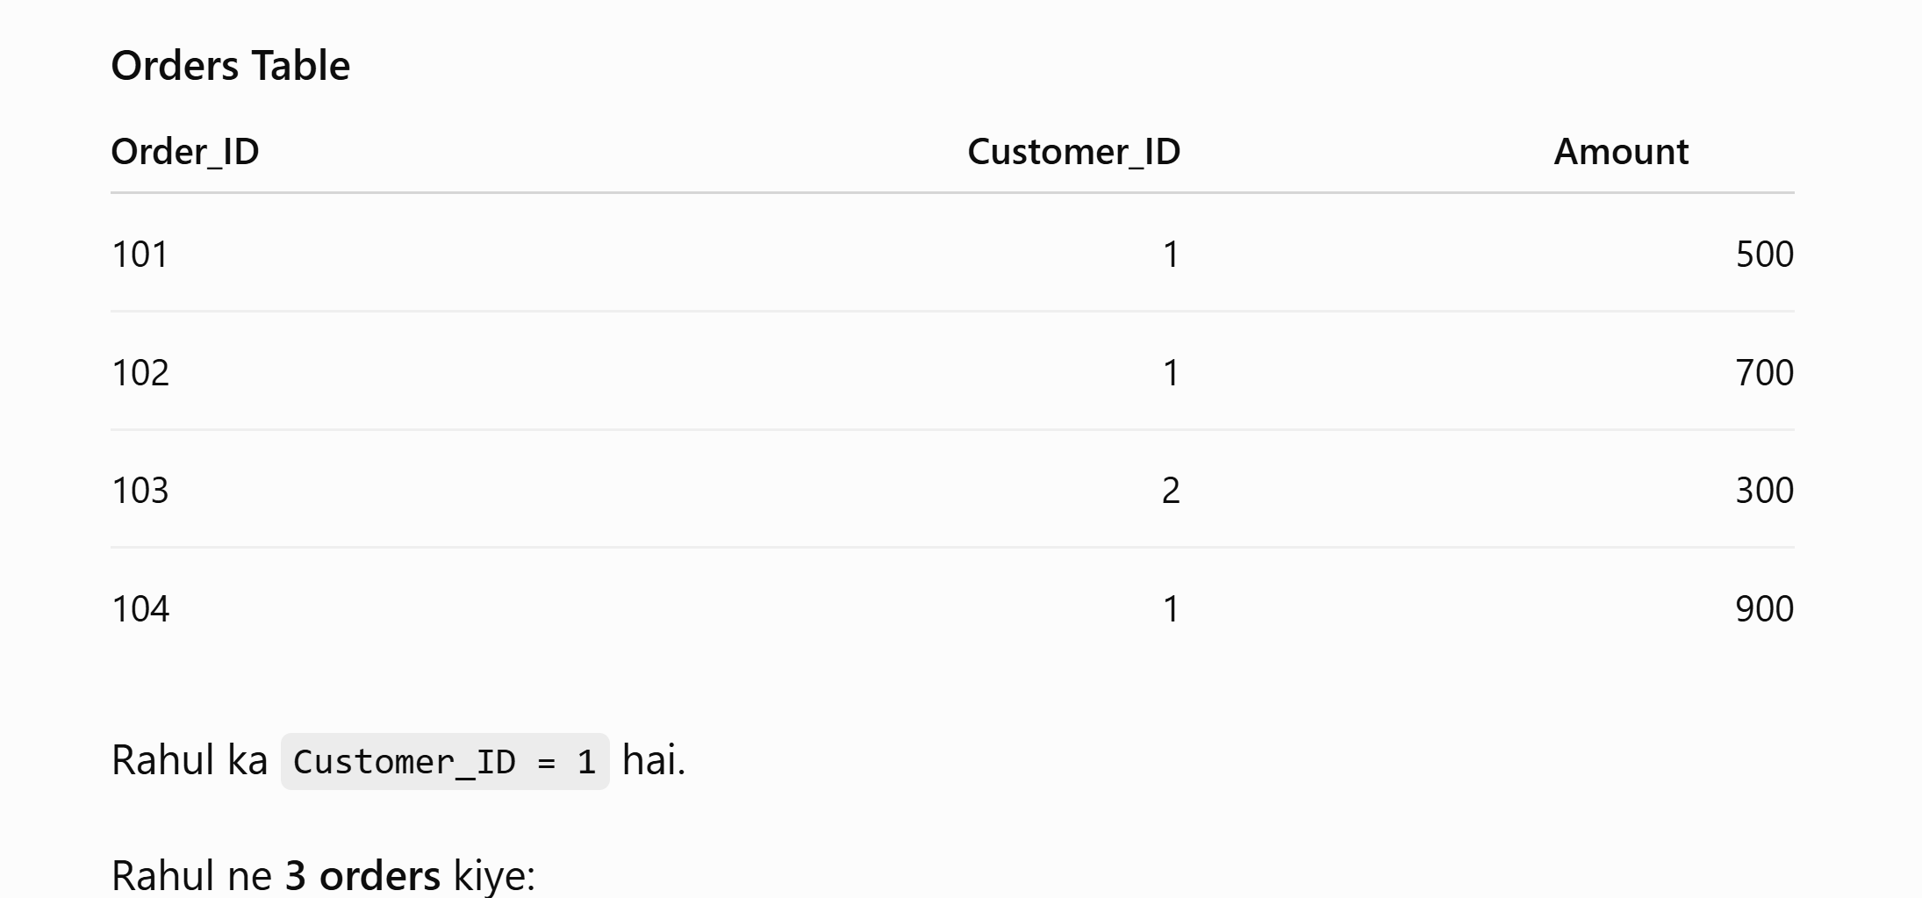
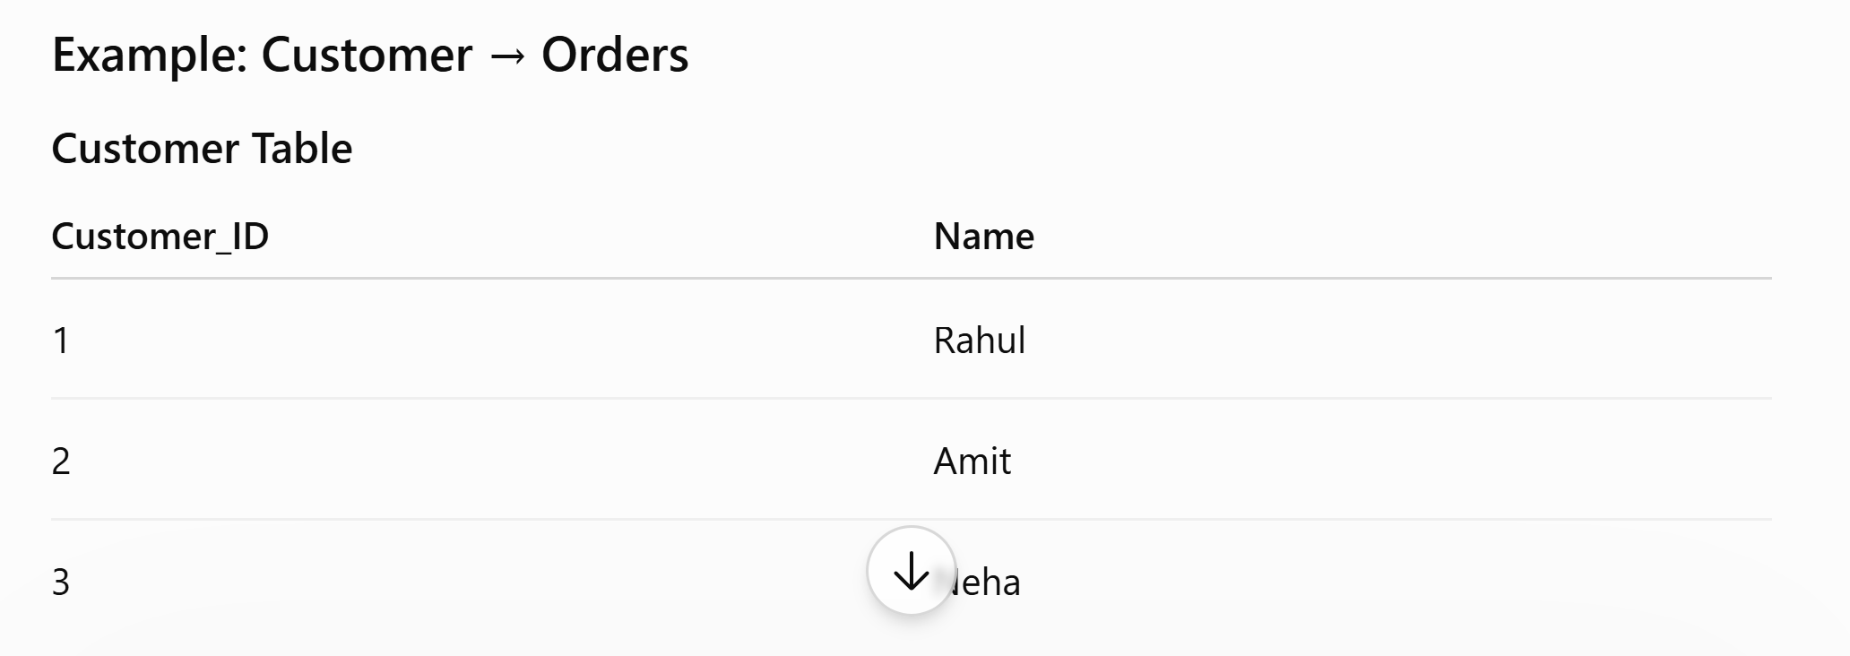
One-to-Many (1 : *)
Ek record doosri table mein multiple records se related ho sakta hai.
**1 Customer ke MANY Orders ho sakte hain = 1 : ***
**1 Customer ke MANY Orders ho sakte hain = 1 : ***

Slide 31
Many-to-Many (* : *)
Dono tables ka ek record doosri table ke multiple records se related ho sakta hai.

Slide 32
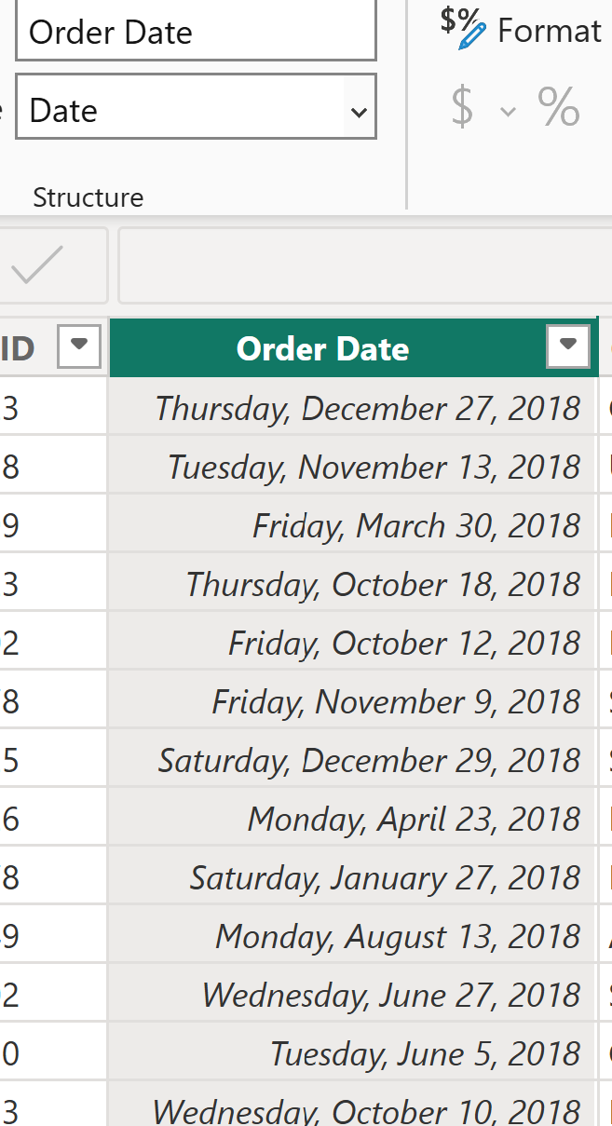
Date change
order

Slide 33
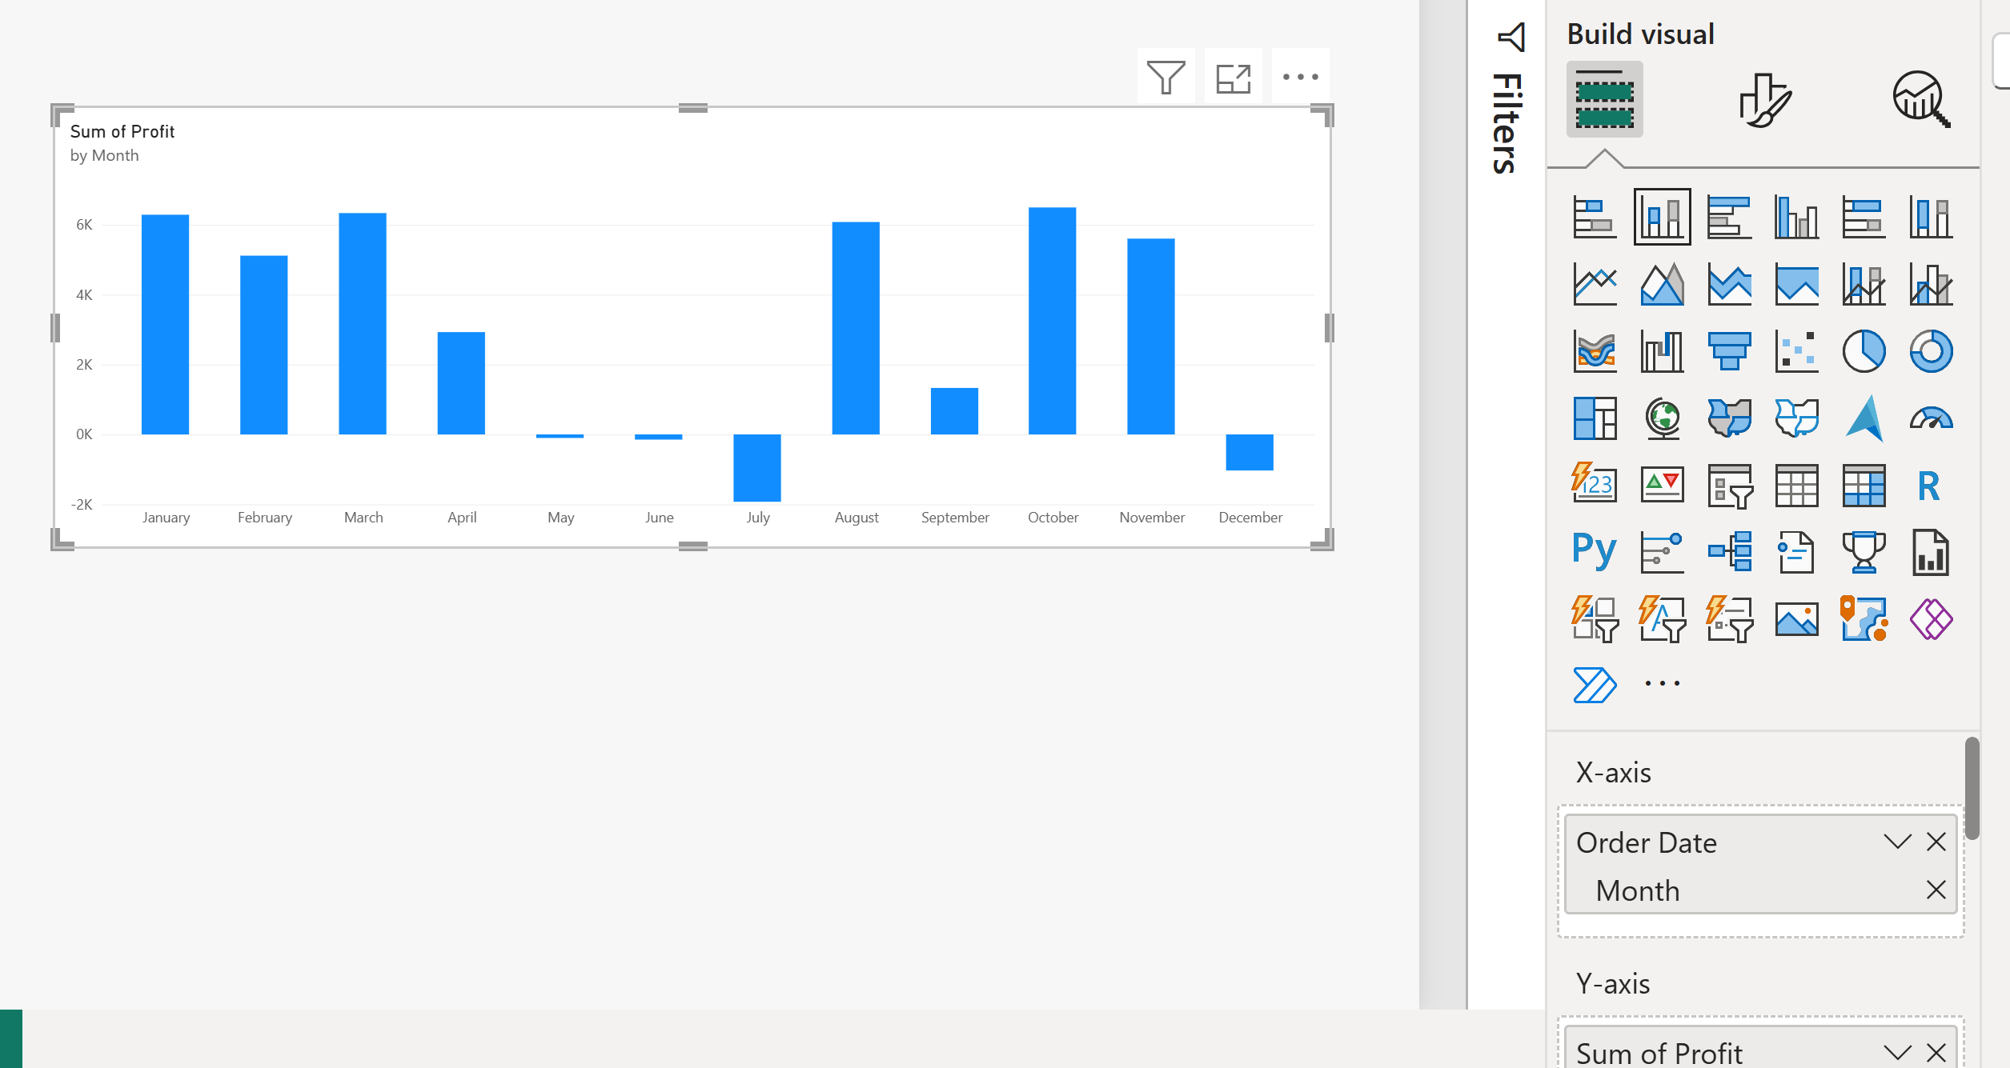
Sum of profilt

Slide 34
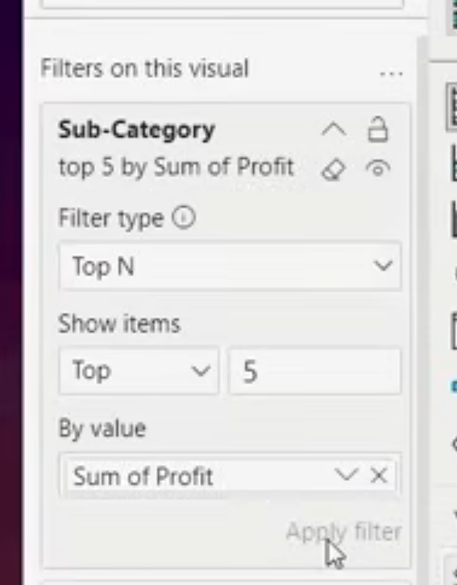
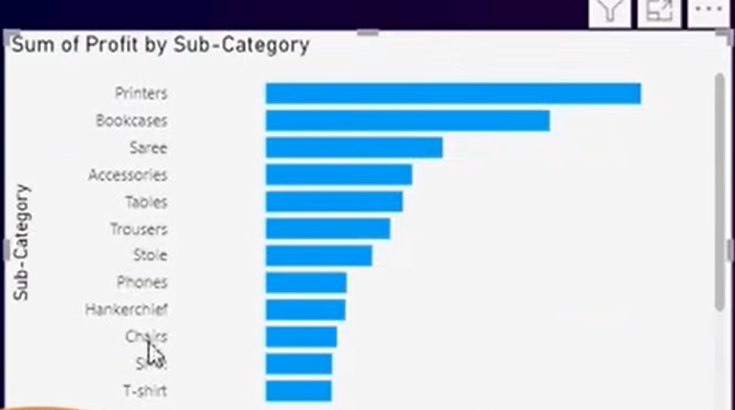
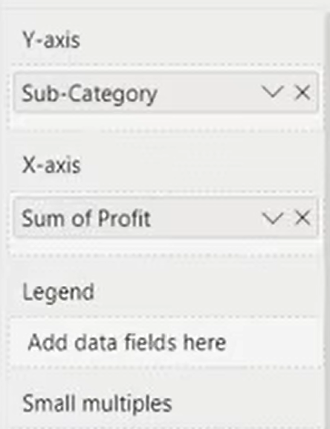
Sum of profit by sub-category

